Slide 1
Indexing

Slide 2
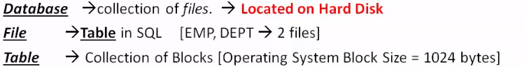
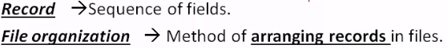
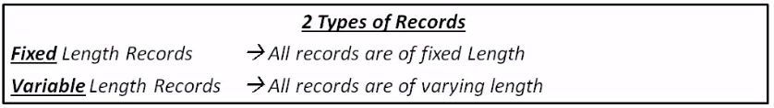

Slide 3
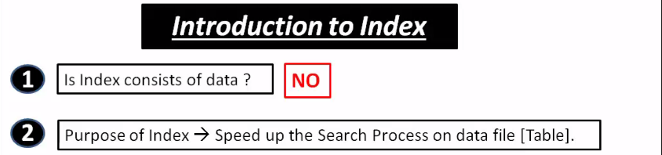
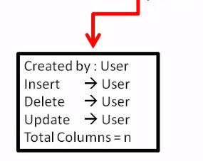
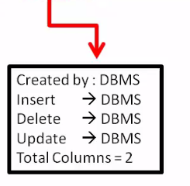

Slide 4
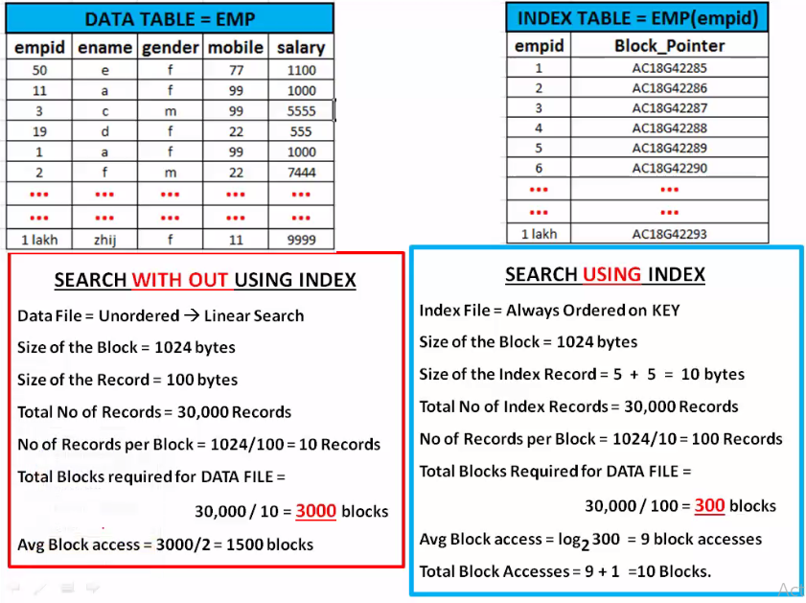

Slide 5
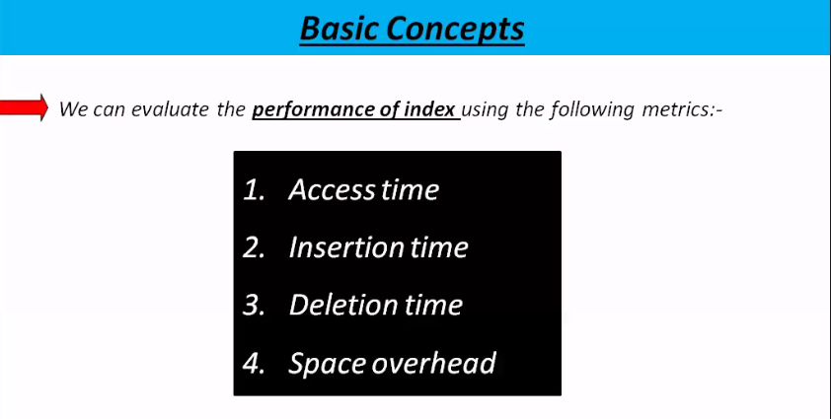

Slide 6
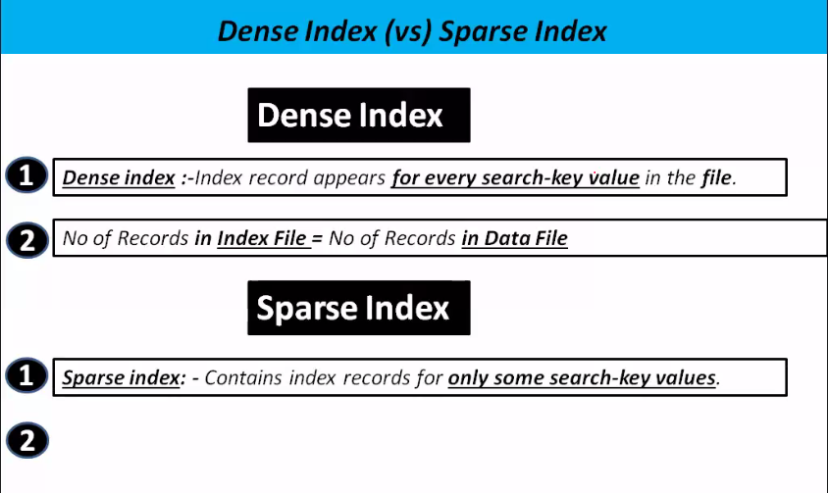

Slide 7
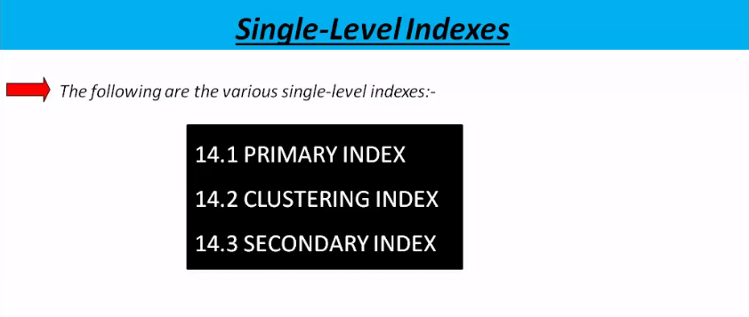

Slide 8
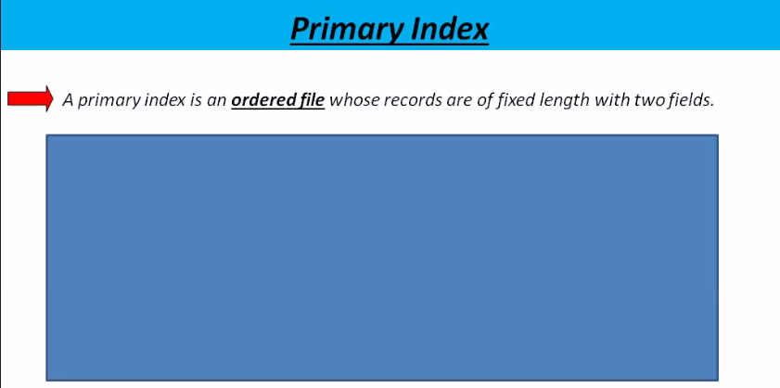


Slide 9
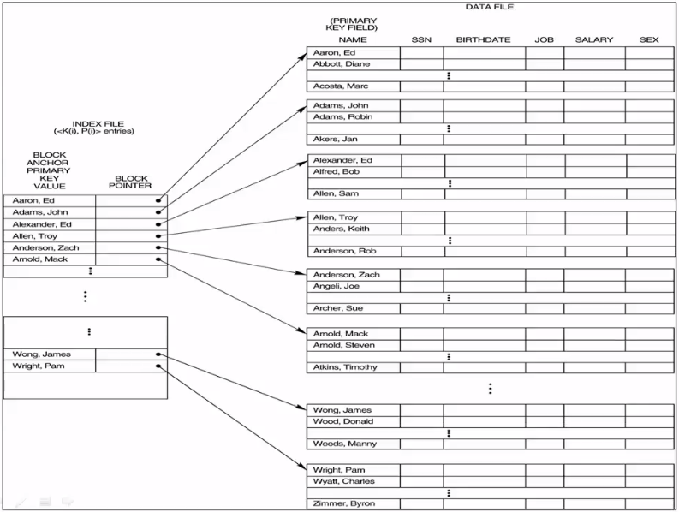

Slide 10
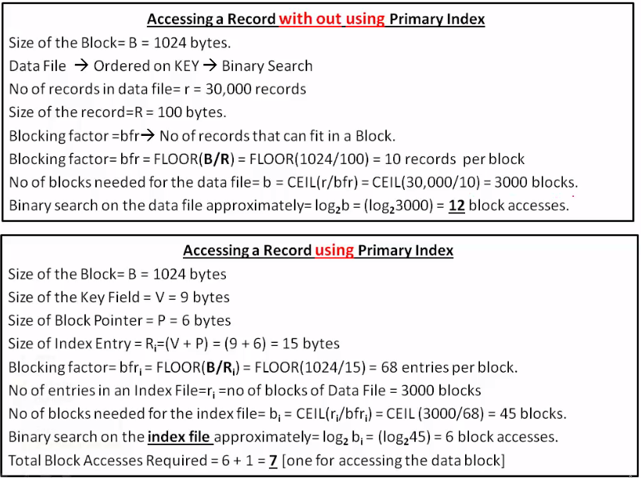

Slide 11
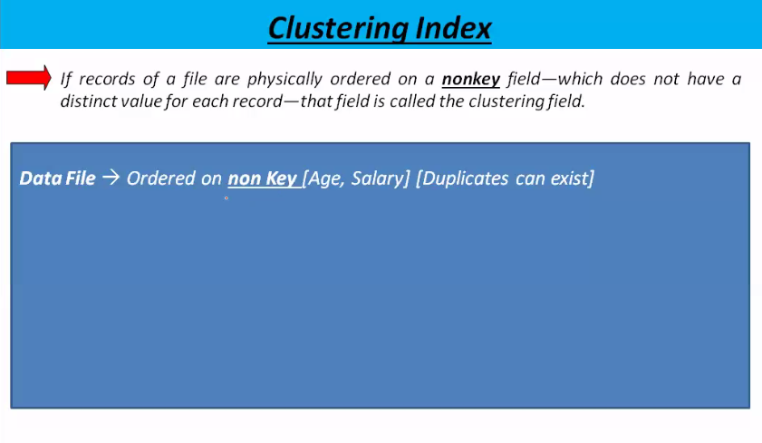
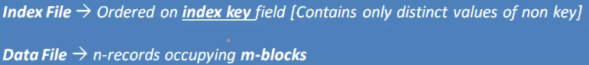

Slide 12
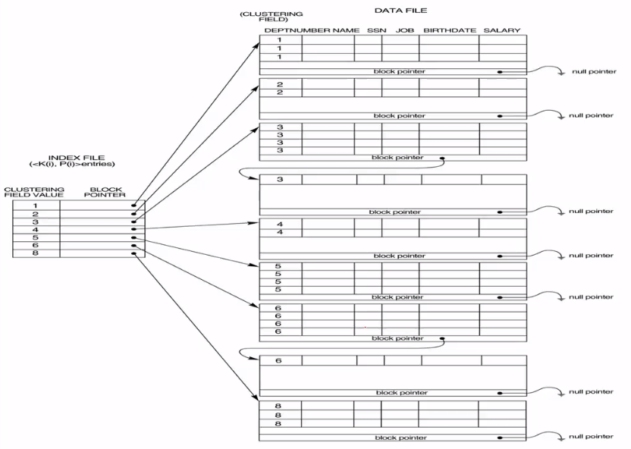

Slide 13
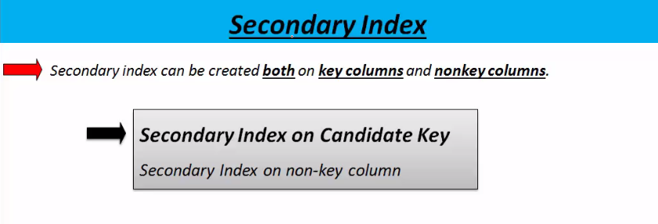

Slide 14
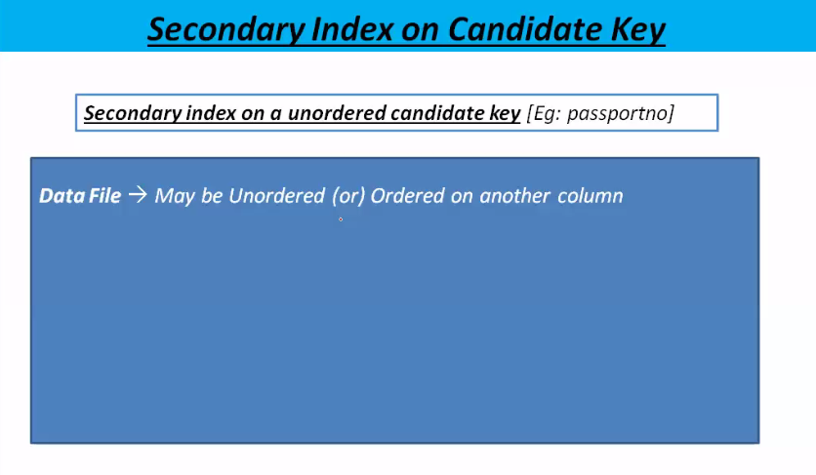


Slide 15
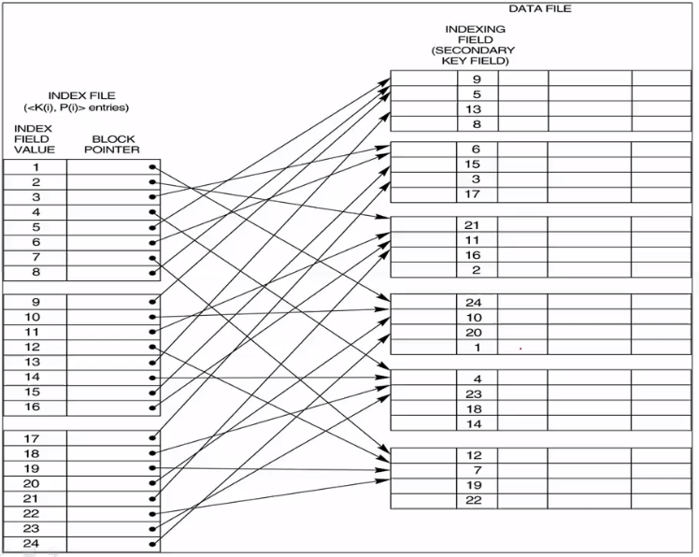

Slide 16
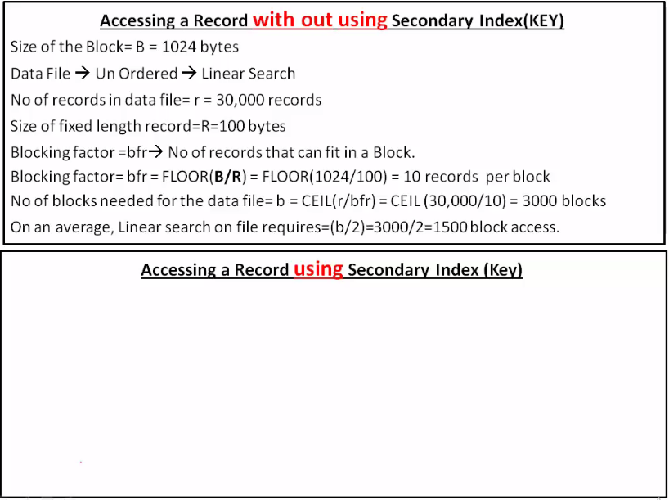
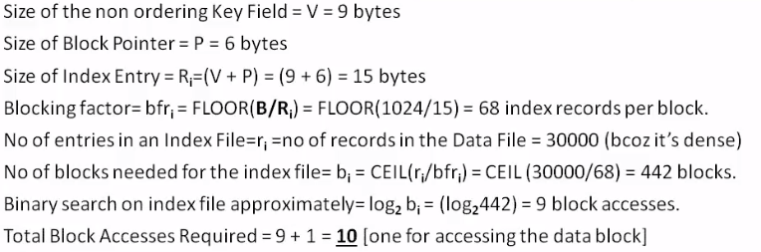

Slide 17
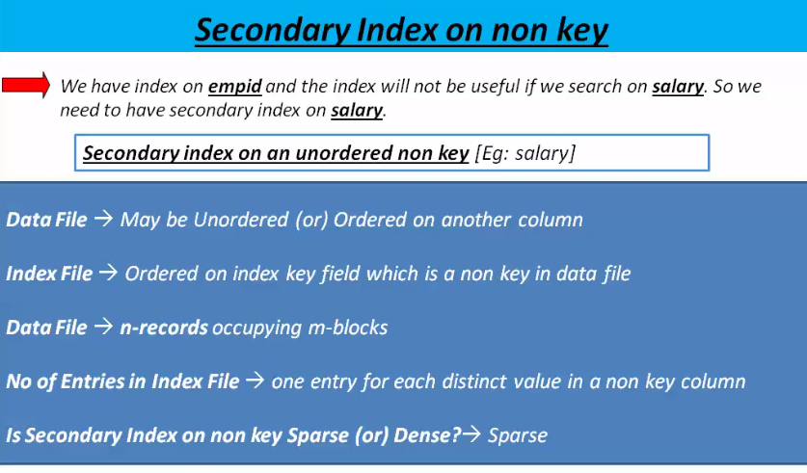

Slide 18
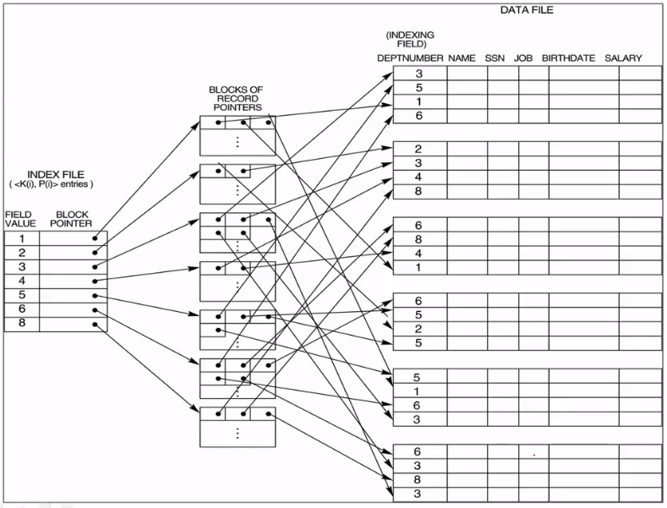

Slide 19
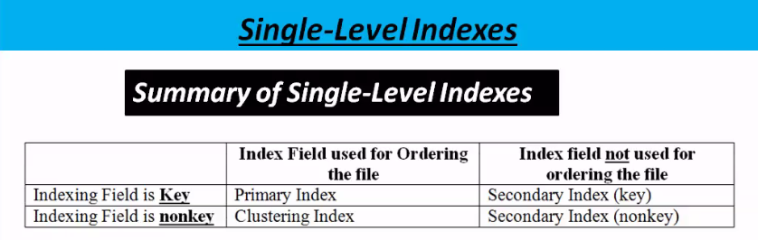
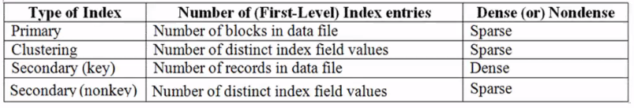

Slide 20
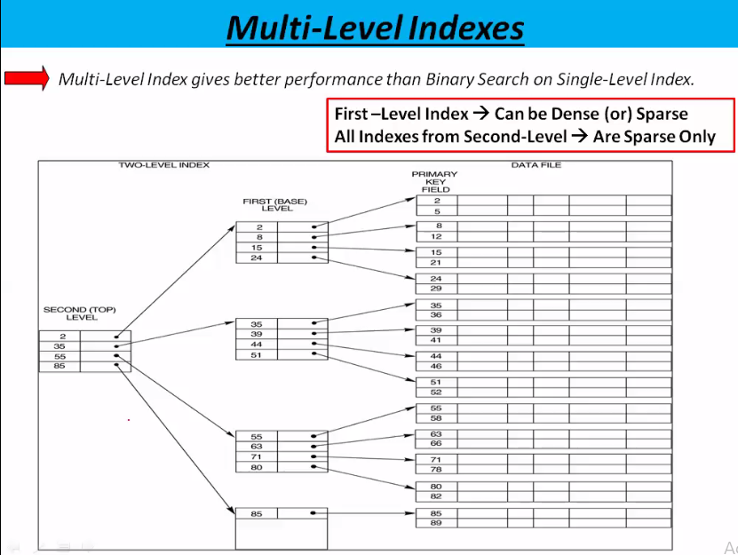

Slide 21
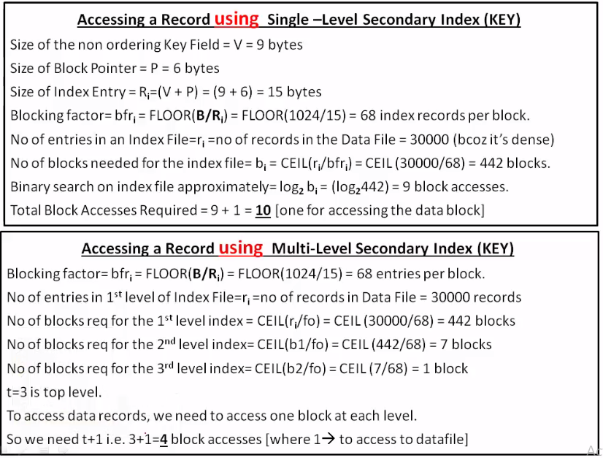

Slide 22
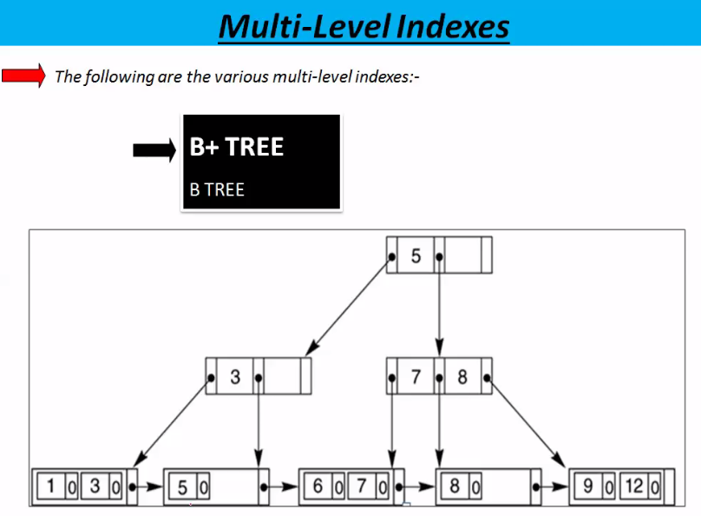

Slide 23
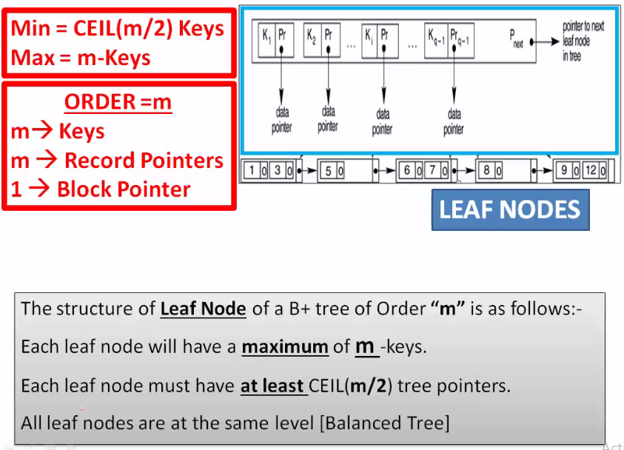

Slide 24
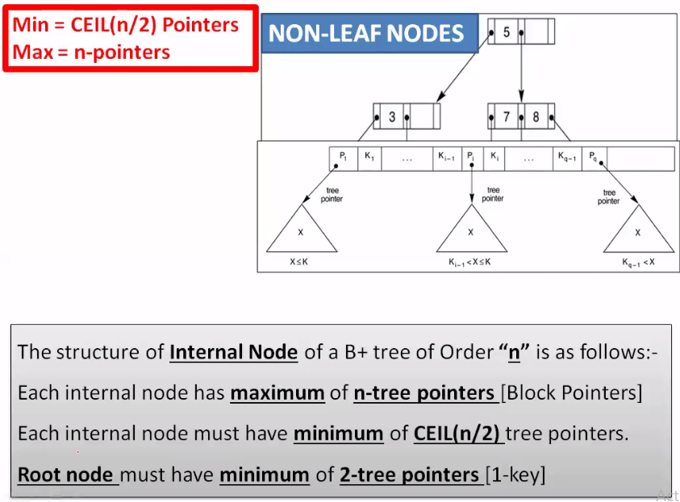
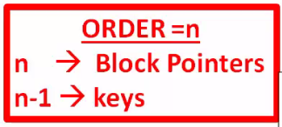


Slide 25
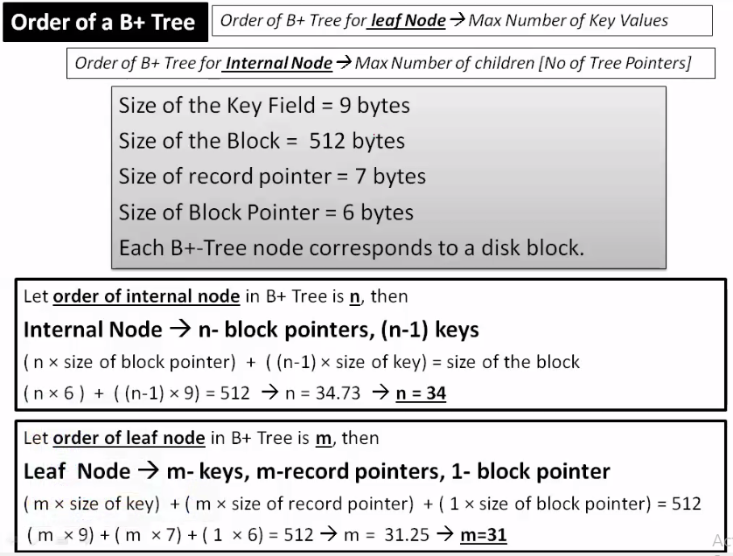

Slide 26
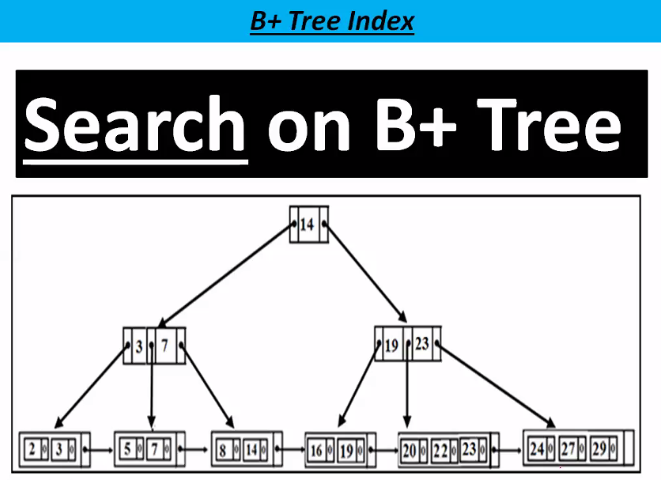

Slide 27
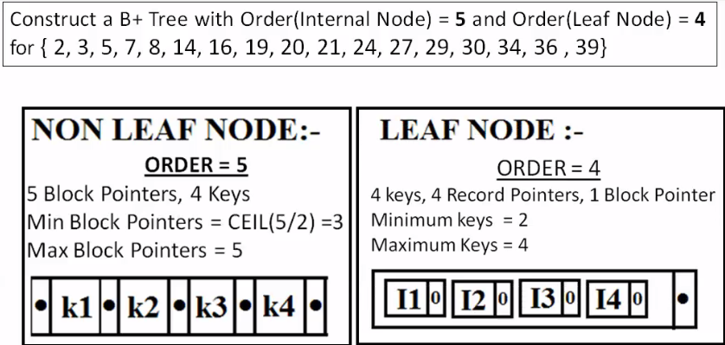
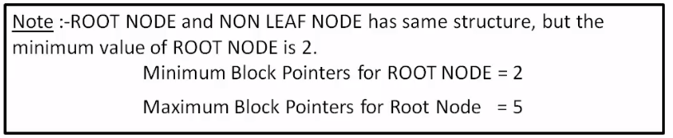

Slide 28
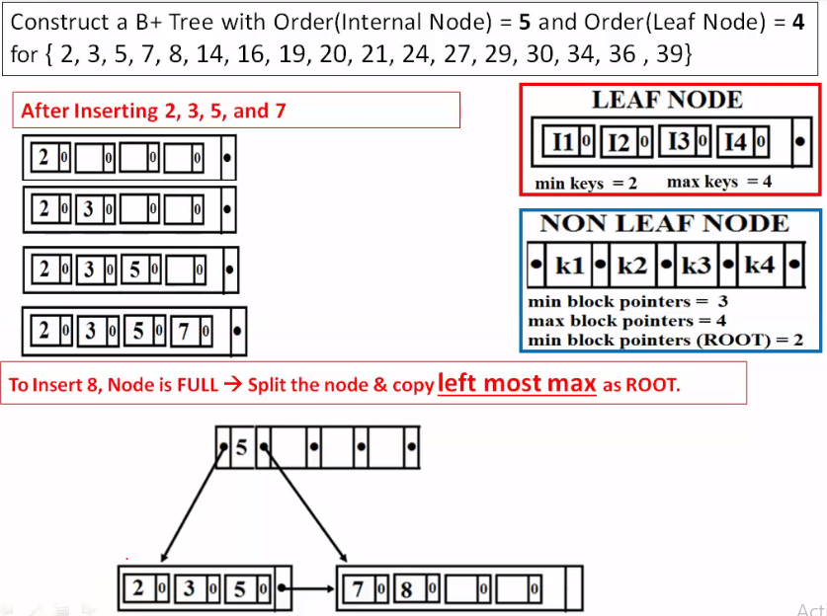

Slide 29
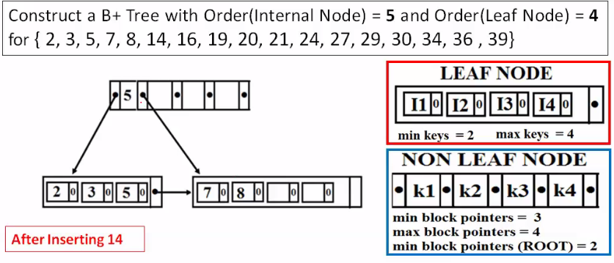
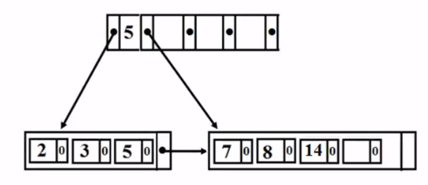

Slide 30
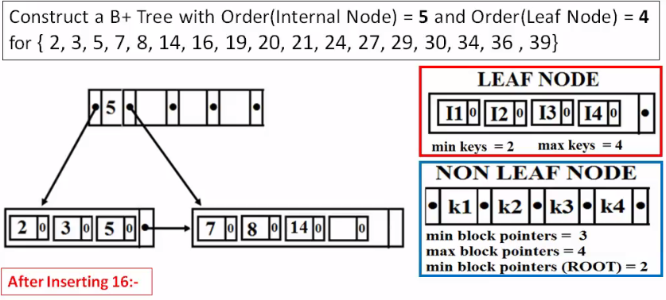
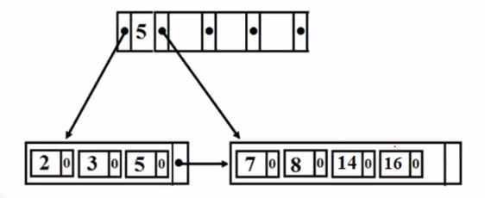

Slide 31
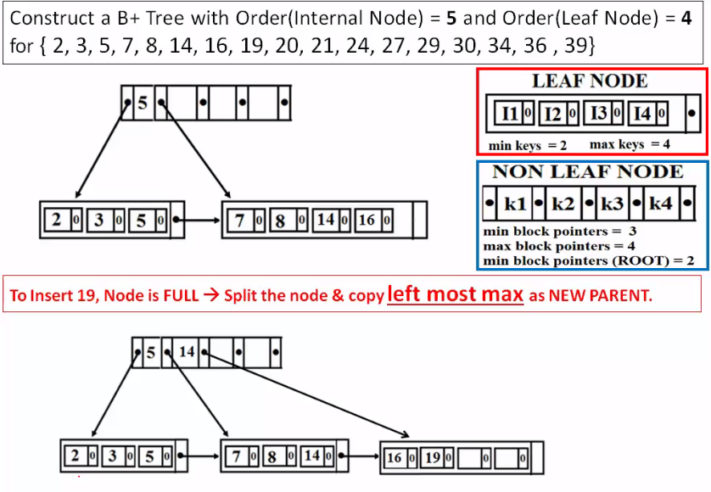

Slide 32
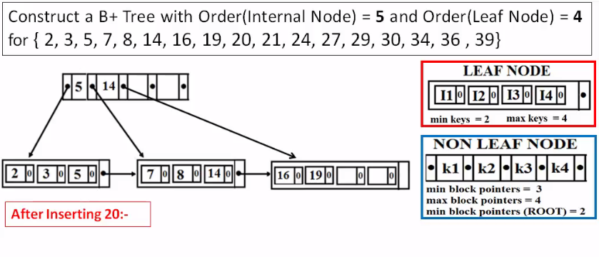
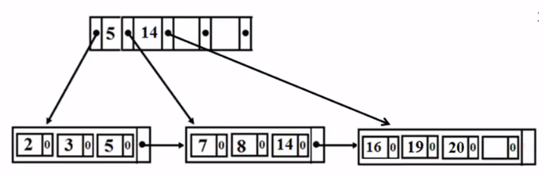

Slide 33
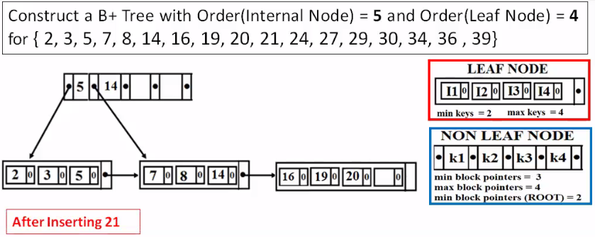
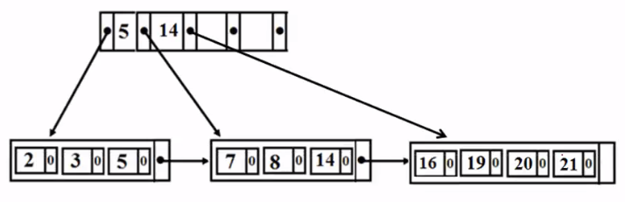

Slide 34
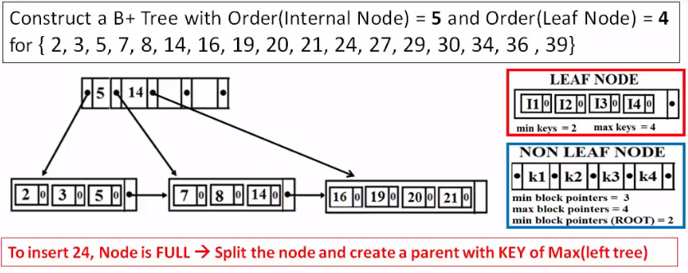
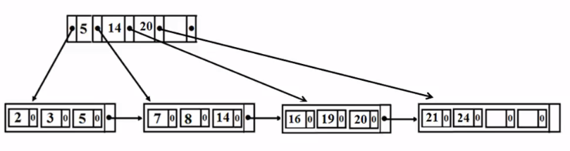

Slide 35
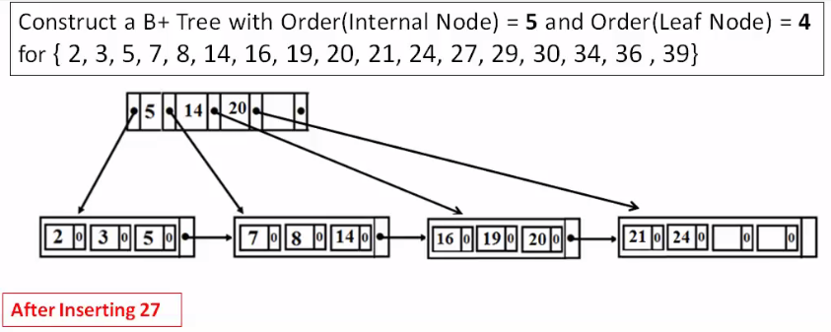
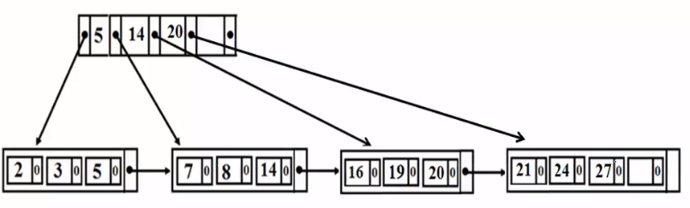

Slide 36
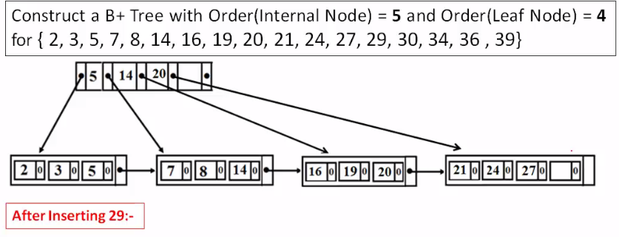


Slide 37



Slide 38



Slide 39



Slide 40


Slide 41


Slide 42


Slide 43


Slide 44


Slide 45


Slide 46


Slide 47






Slide 48


Slide 49


Slide 50




Slide 51



Slide 52



Slide 53



Slide 54



Slide 55



Slide 56



Slide 57



Slide 58



Slide 59



Slide 60



Slide 61



Slide 62



Slide 63



Slide 64


Slide 65


Slide 66



Slide 67



Slide 68


Slide 69



Slide 70



Slide 71



Slide 72



Slide 73



Slide 74


Slide 75


Slide 76


Slide 77



Slide 78


Slide 79


Slide 80
Hashing
Hashing is an efficient technique to calculate the direct location of a data record on the disk without using index structure
Hash organization:-
- Bucket:- A hash file stores data in bucket is considered a unit of storage.
- Hash Function:- A hash function h, is mapping function that maps all the set of keys to the address where actual records are placed.

Slide 81
Hashing
131 | Yug
130 | Yash
142 | Jeet
058 | Yashik
021 | Tanmay
059 | Sahil
057 | Aniket
Yashik
058
Hash Function
142
Jeet
021
Tanmay
Key
Address

Slide 82
Hashing
1) Static Hashing :-
In static hashing, when a key value is provided, the hash function always computes the same address.
If we want to generate address for a key using mod(5) hash function it always result in the same.
No. of data buckets in the memory for this static hashing remains constant.

Slide 83
Hashing
Ex. Mod(4) has only 5 values.
2) Dynamic Hashing:-
The drawback of static hashing is that it does not expand or shrink to dynamically as the size of the database grow or shrink
In Dynamic hashing data bucket grows or shrink (added or removed dynamically) as records increase or decrease.

Slide 84
Hashing
Extended Hashing :-
It is a dynamic methods where in directories & buckets are used to hash data.
It is an flexible methods in which the hash function also experience dynamic change.
Directories:-
The directories store address of the buckets in pointer and id is assigned to each directory, which may change each time when directory expansion take place.

Slide 85

Difference between indexing and hashing

Slide 86
Bitmap Index
Bitmap index are feature of oracle.
In bitmap index oracle create bitmap for each unique value of single column.
Each bitmap contains a single bit (0 r 1) for every row in the table.
1 indicate that the row has value specified by the bitmap, and 0 indicate that it does not.
Oracle scans then bitmap to find row matching specified criteria.
Bitmap indexes are suitable for column with limited no. of distinct values.

Slide 87
Bitmap Index
Roll | Name | Gender | BE% _above_60 | DL
01 | Yashik | M | Yes | Yes
02 | Mitali | F | Yes | Yes
03 | Yash | M | No | Yes
04 | Yug | M | Yes | No
05 | Dhruvi | F | No | Yes
Male | Female
1 | 0
0 | 1
1 | 0
1 | 0
0 | 1
Yes | No
1 | 0
1 | 0
0 | 1
1 | 0
0 | 1
Yes | No
1 | 0
1 | 0
1 | 0
0 | 1
1 | 0

Slide 88
Bitmap Index
Select * from students where genders=‘M’ and BE%_above_60 = ‘Yes’ and DL=‘Yes’
Male
1
0
1
1
0
Yes
1
1
0
1
0
Yes
1
1
1
0
1
1
0
0
0
0
AND
AND
=

